Slide 1

Hunted
A demon hunter must prevent a group of demons from opening an escape portal in a competitive, team based board game.
By Mateusz, Thomas

Slide 2
What We are doing
1v2-1v4 board game.
One demon hunter vs multiple demons.
Competitive, team based.
Set in Victorian England.

Slide 3
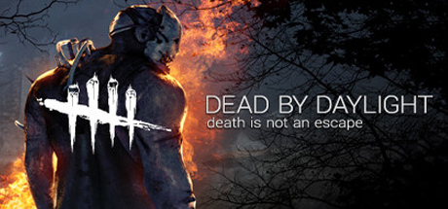
Why we are doing it
To create Board game about feeling trapped, with someone trying to hunt you down.
Twist on the idea, the hunted are bad, the hunter is good.

Slide 4
How we are doing it
Creating the board game using a board, cards, dice and character tokens.

Slide 5
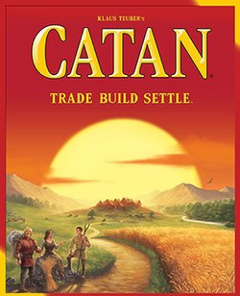
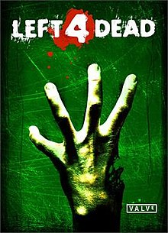
Key facts
Competitive board game, with cooperation between demons.
3-5 players
30-60mins

Slide 6
Key facts
Single purchase, €40.
Expansions possible down the line.
Release date: TBD
Team of 2, Mateusz and Thomas
Summary: Asymmetrical competitive board game set in demon-infested Victorian England.

Slide 7
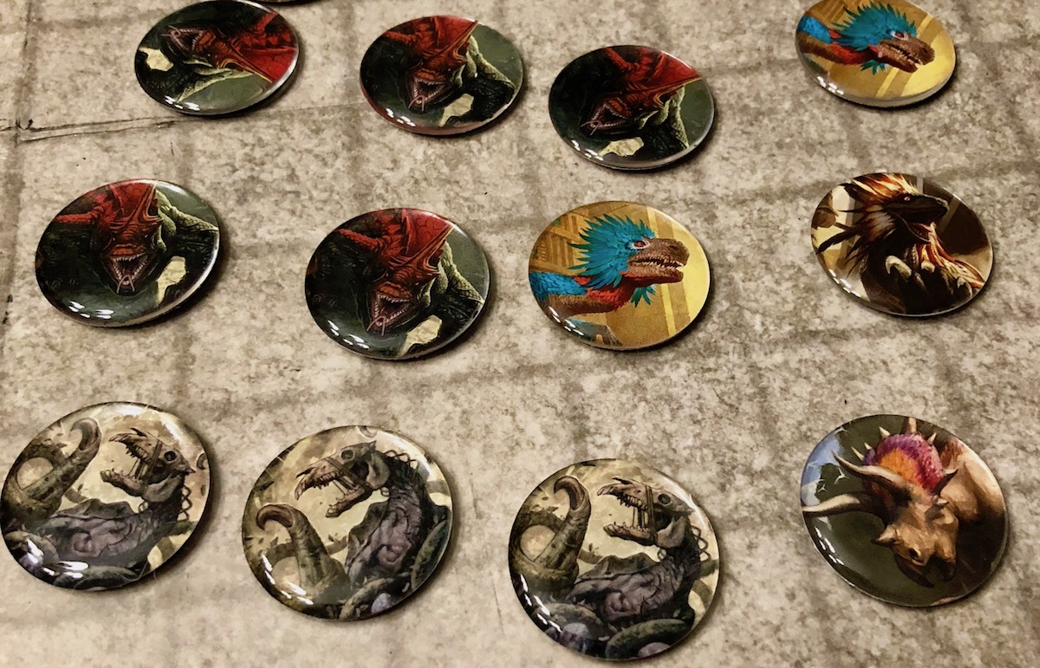
Gameplay
1v2-1v4.
2 character tokens per player.
Each one moves independently.
Turn based.

Slide 8
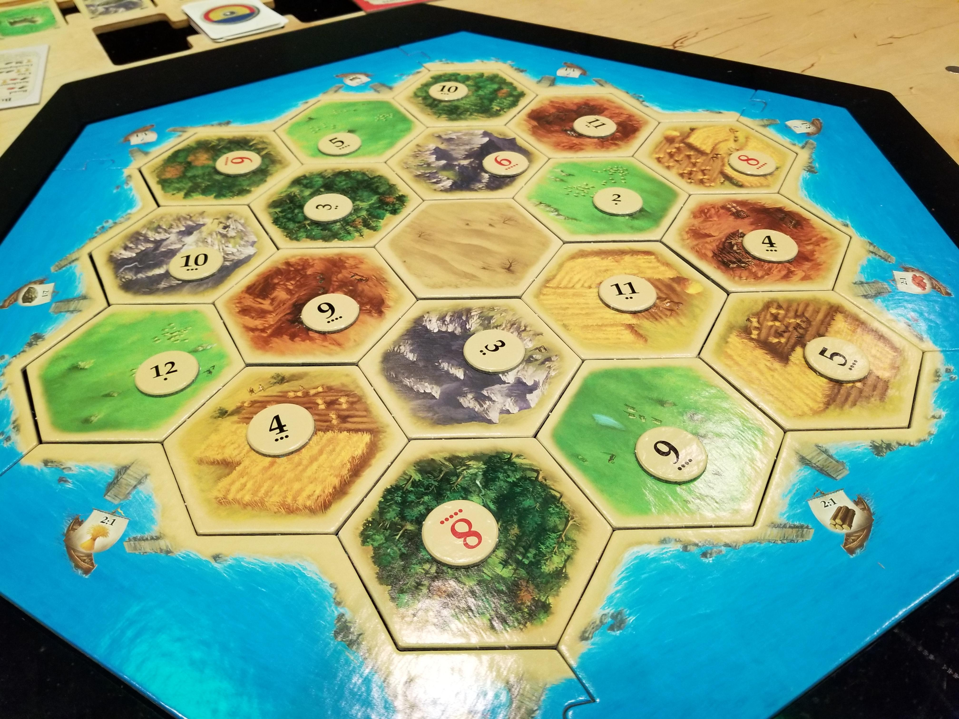
Demon GAmeplay
Demons can't fight directly.
Draw ability cards to slow down demon hunter.
Demons complete objectives to spawn an escape portal.
Objectives randomly placed on the board

Slide 9
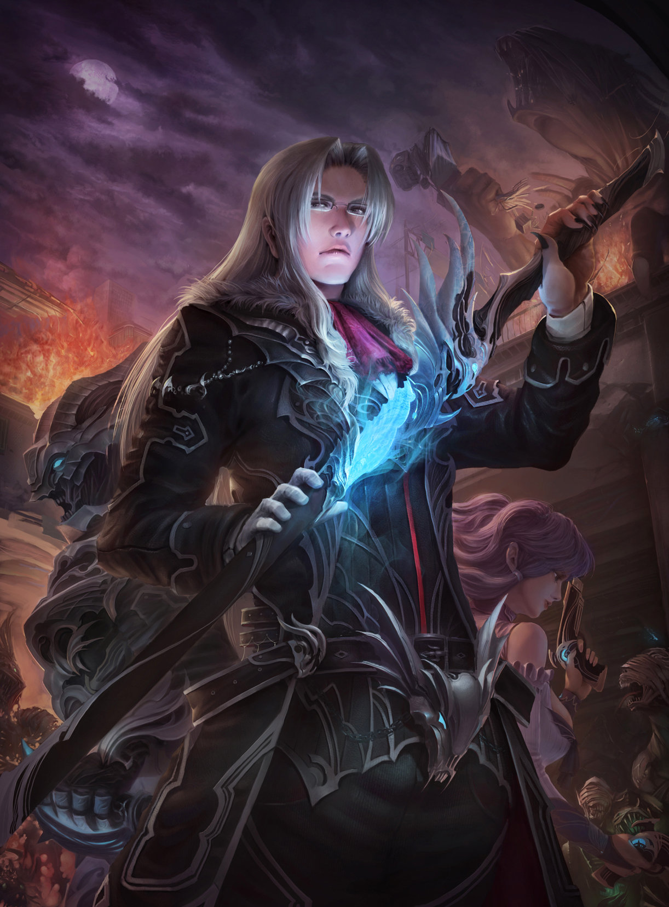
Demon Hunter GAmeplay
Demon Hunter kills demons.
Sabotages objectives.
Wins if all demons are dead.

Slide 10
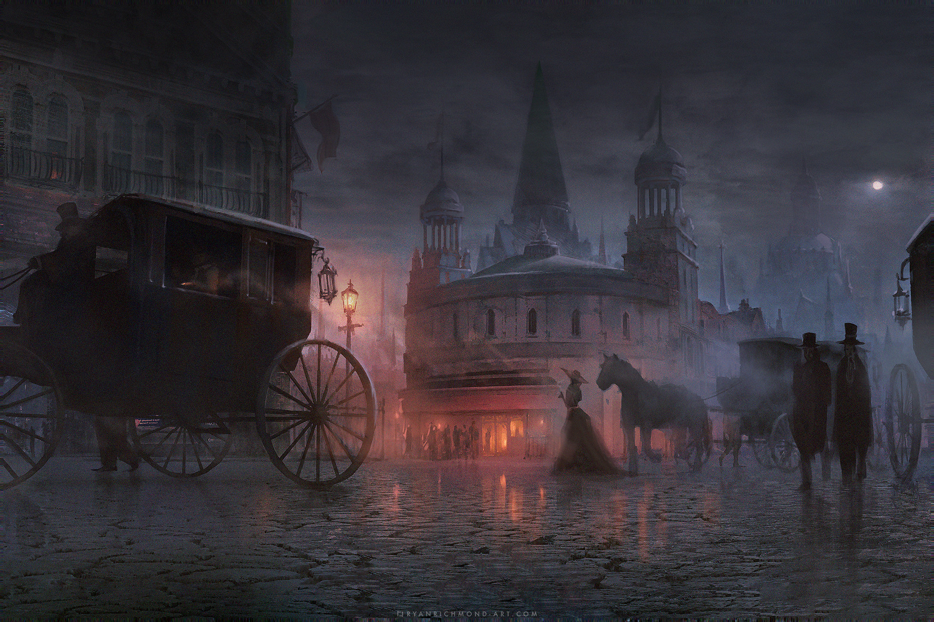
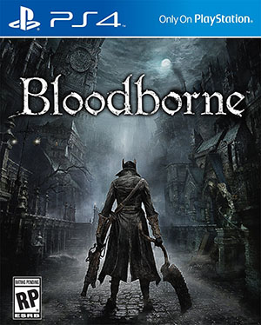
Theme
Inspired by Victorian era aesthetic.
Similar to Bloodborne, more explicit demons.
Good vs Evil.

Slide 11
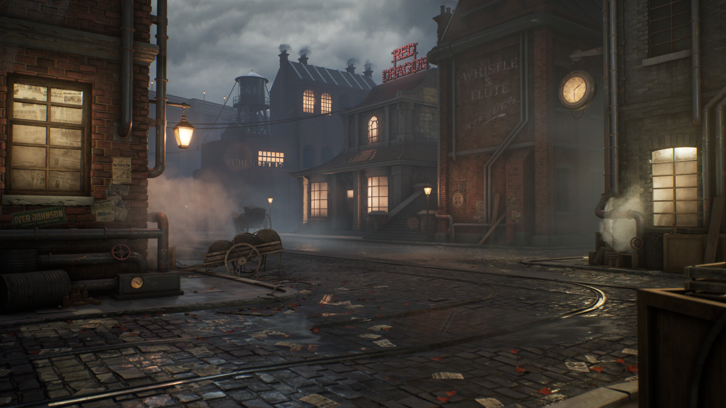

Slide 12
